Slide 1

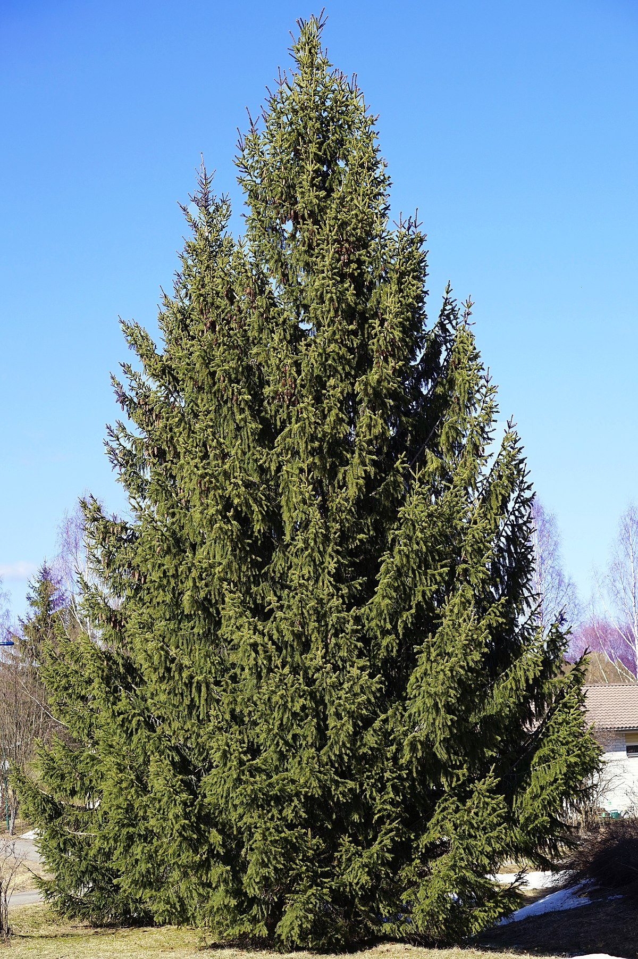
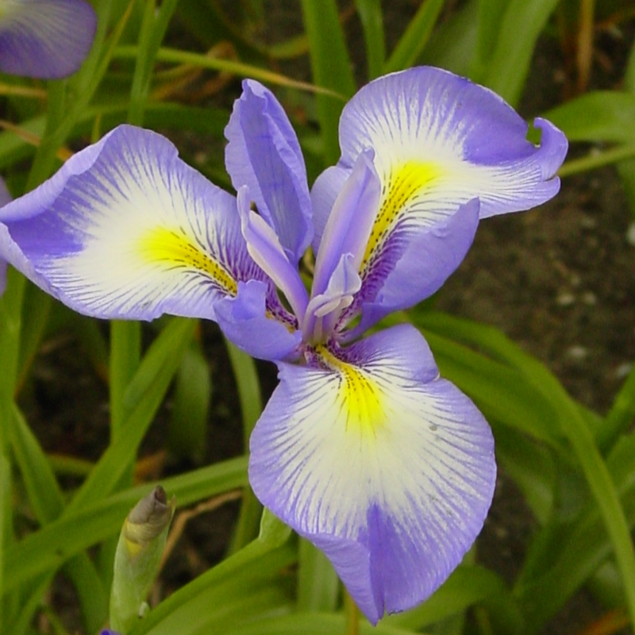
Assembly and analysis of organelle genomes of Iris species and Picea abies
Students: Alexandr Andreev,
Forest technical university
Zhurbenko Peter,
BIN RAS
Supervisors:
Mikhail Raiko,
Lavrenty Danilov
Bioinformatics institute

Slide 2
Project goal: to write a pipeline for organelle genome assembly based on the reference. Assemble and analyze the mitochondrial genome of Picea abies and chloroplast genomes of irises (own sequence data)
Project tasks:
Genome assembly of irises and Picea using reference;
Phylogeny analysis of Iris species;
Search for nuclear mitochondrial DNA (NUMT) in Picea genome.

Slide 3
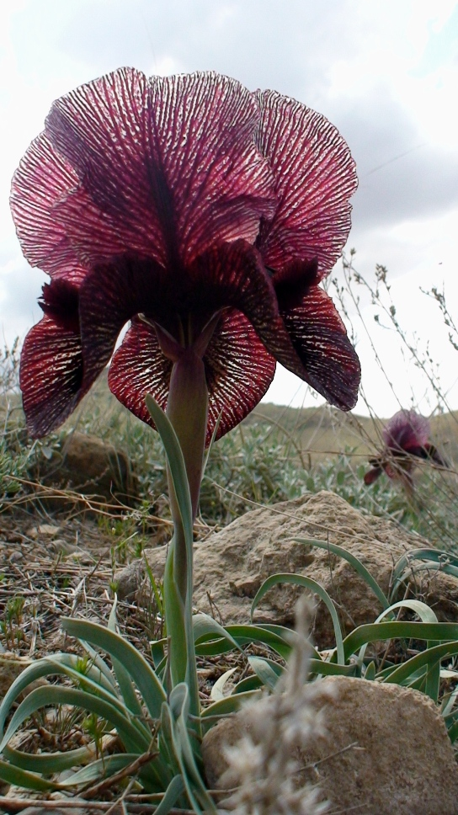
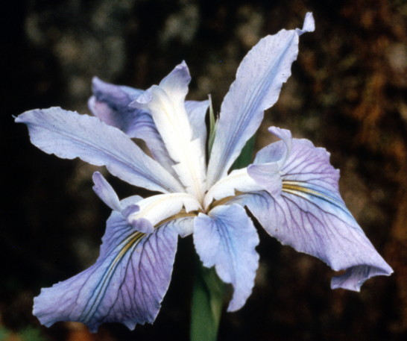
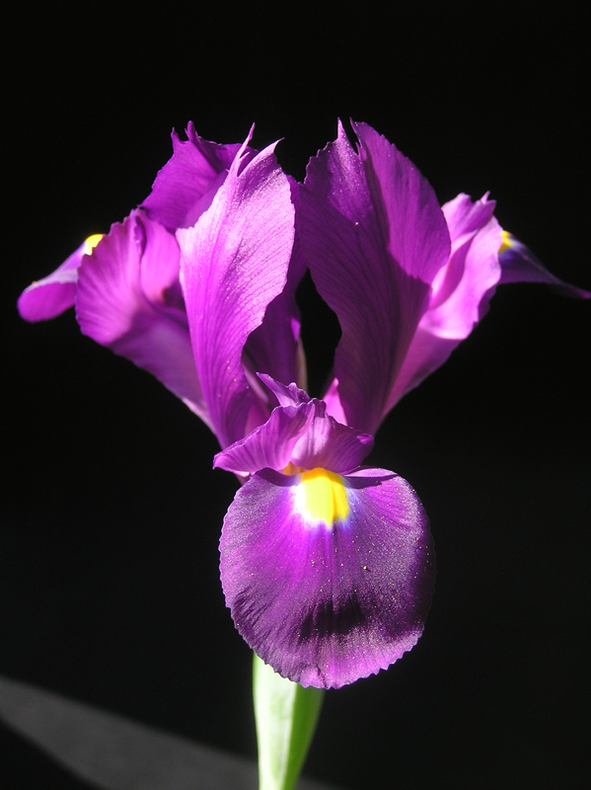
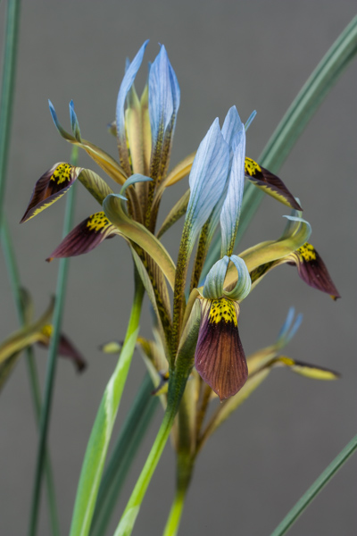
Iris data
We had paired-end Illumina reads of four Iris species: I . lycotis, I. munzii, I. filifolia and I. pamphilica.
1
2
3
4
Fig 1. Iris species
1 - I . lycotis, 2 - I. munzii, 3 - I. filifolia, 4 - I. pamphilica

Slide 4
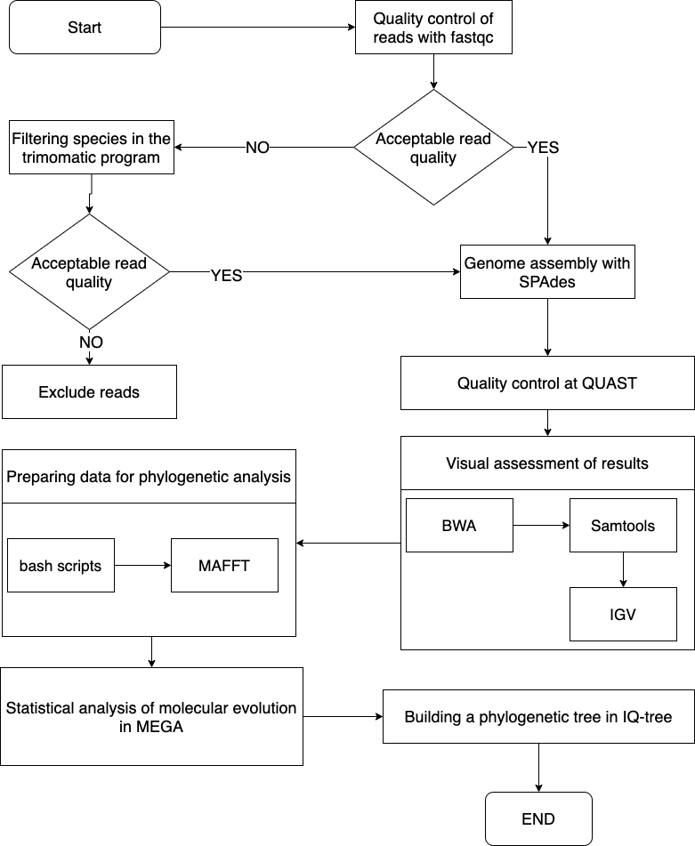
Design of experiment. Plastome assembly
Paired-end Illumina reads of Iris species were filtered by quality control in Trimmomatic (v0.39) and then assembled using SPAdes (v3.12). The assemble quality control was performed by aligning the scaffolds on the reference genome of I. gatesii using QUAST (v5.1) and BWA (v0.7.17). Well-assembled scaffolds along with homologous sequences of Iris species available in GenBank were used to construct the phylogeny.
Fig. 2 pipeline for Iris plastome assembly

Slide 5
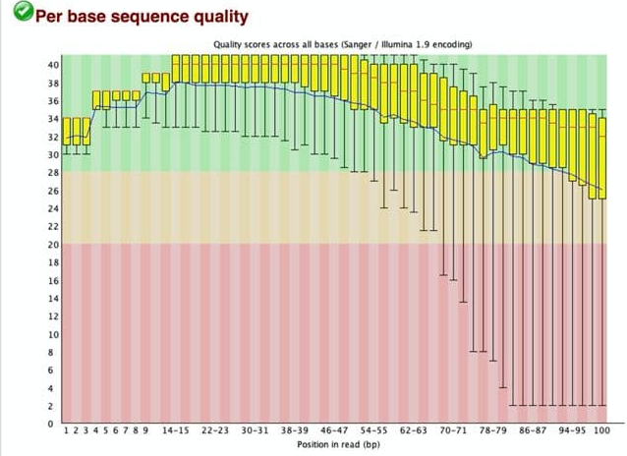
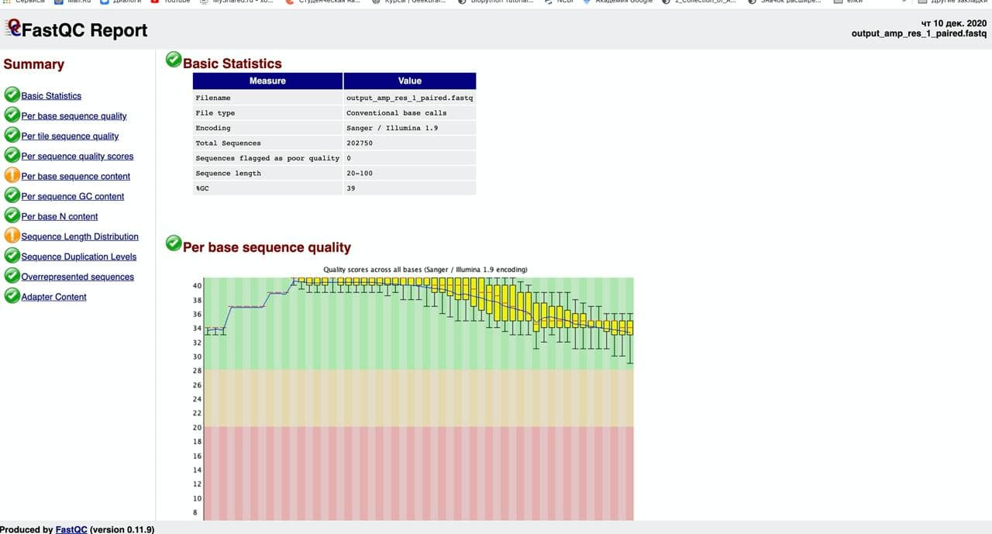
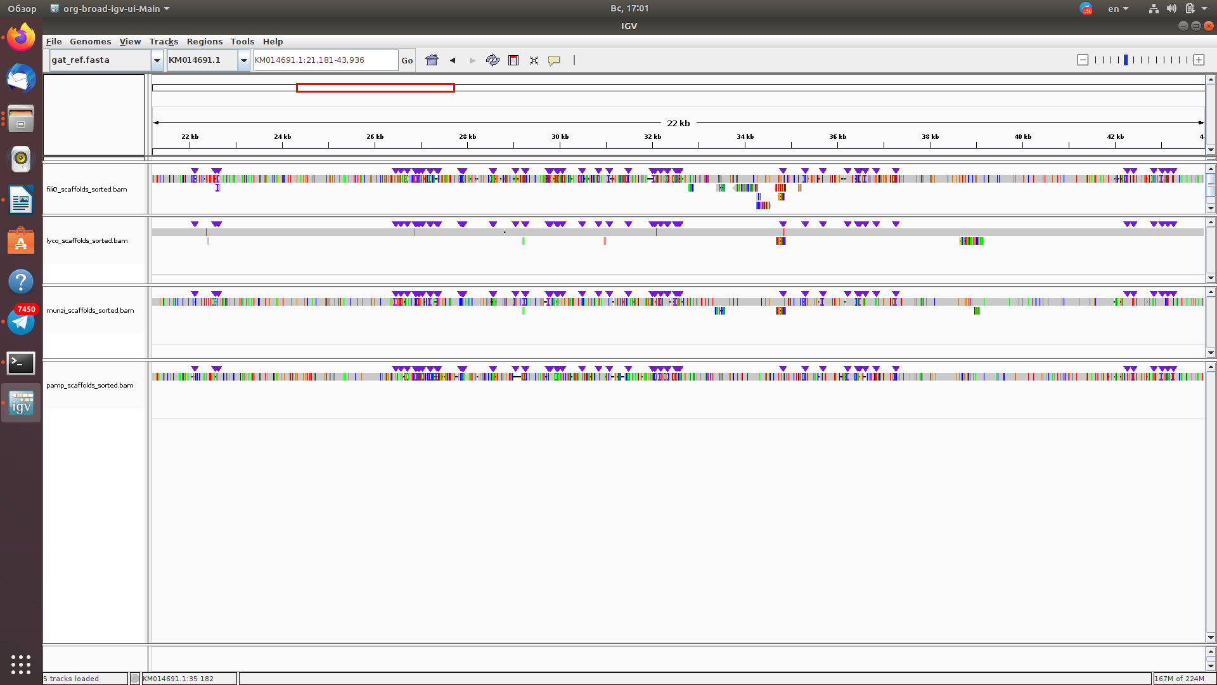
Quality control of reads and genome assembly
Fig. 3 Quality control by Trimmomatic for I. filifolia reads with parameters: LEADING:20 TRAILING:20 SLIDINGWINDOW:10:20
Fig. 4 Alignments of scaffolds to reference. Visualization in IGV browser

Slide 6
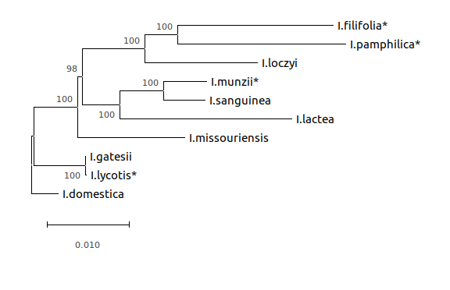
Phylogenetic analysis
The final 70kpb alignment included 10 species belonging to four Iris subgenera. The phylogeny was constructed in the IQ-tree with maximum likelihood method and 1000 bootstrap
Our data confirmed the phylogeny of the studied species, obtained earlier by five chloroplast genes (Wilson, 2011);
Fig. 5 Phylogenetic tree of iris species. Newly assembled species marked with asterix

Slide 7
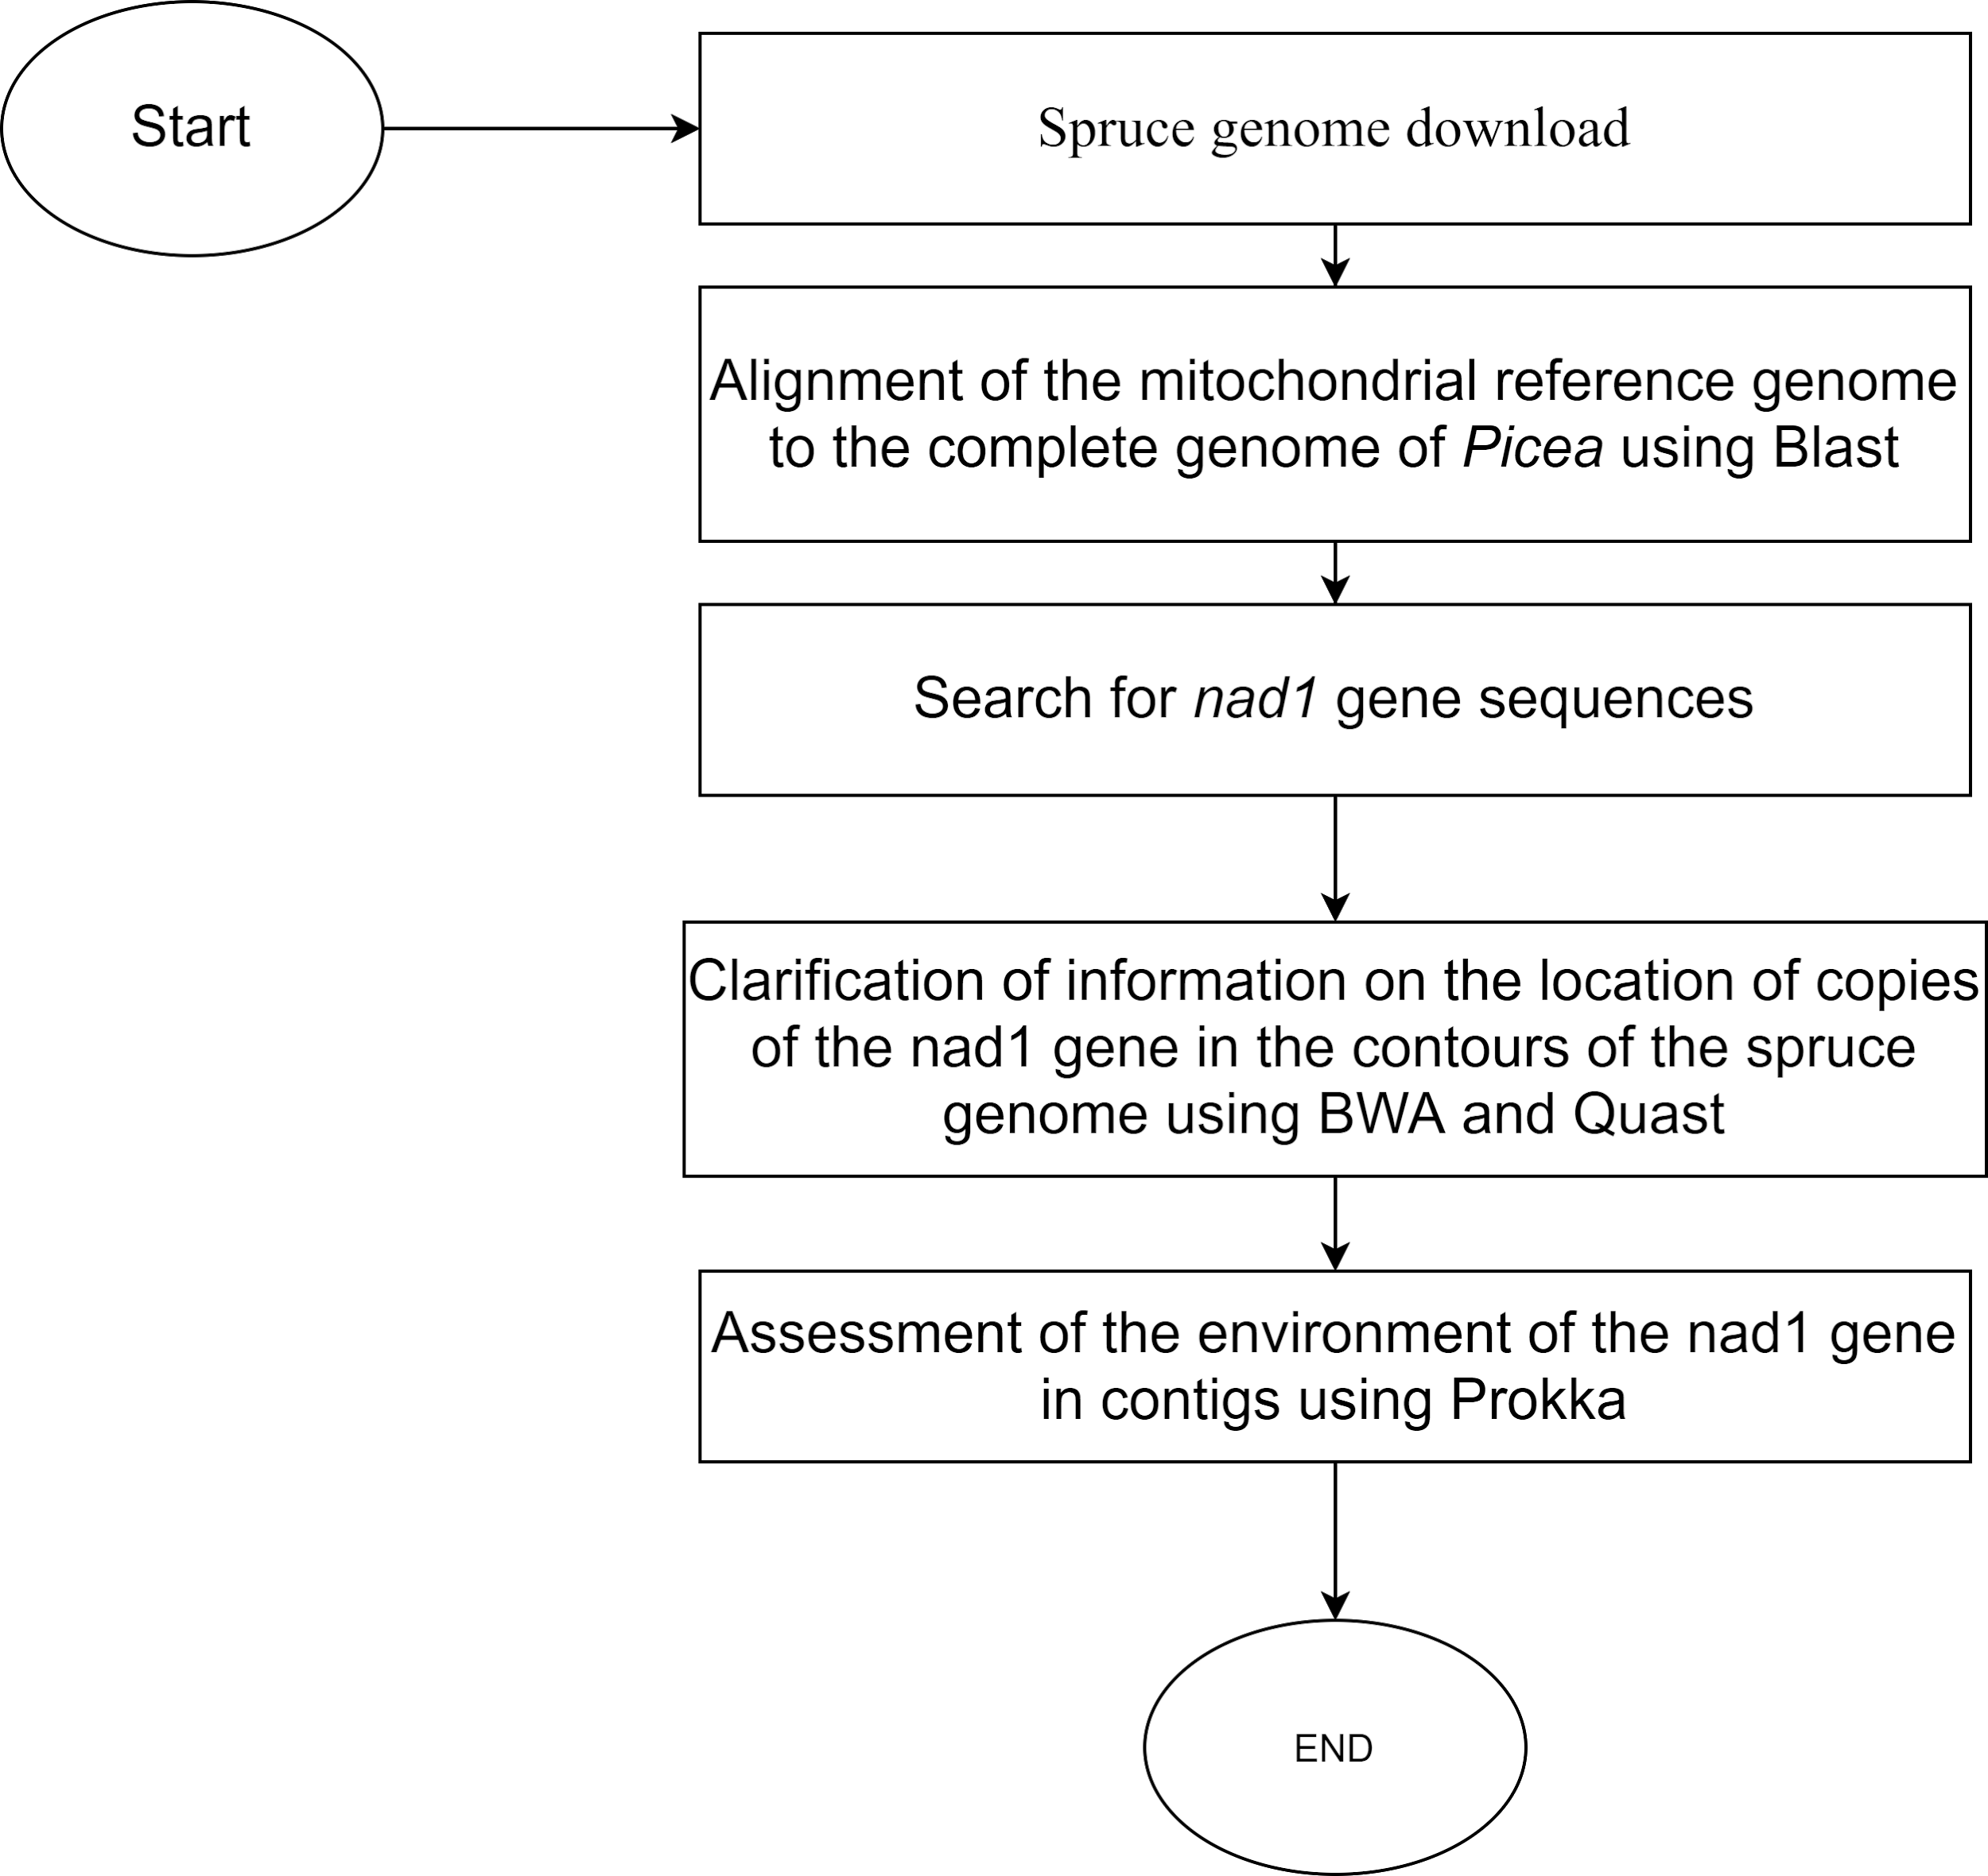
Design of experiment. Picea abies mitDNA analysis
To study the P. abies genome, we used data from Nystedt et. al 2013. The reference mitochondrial genome was obtained from the study of Sullivan A. et al. (2020)
Based on earlier gel electrophoresis analysis, it was shown that the NAD1 gene is presented in the genome in multiple copies and can be a NUMT. To test this hypothesis, we selected scaffolds containing this gene using BLAST and QUAST. These scaffolds were annotated using PROKKA and BLAST against NCBI databases.
Fig. 6 Pipeline for NAD1 gene analysis in Picea genome

Slide 8
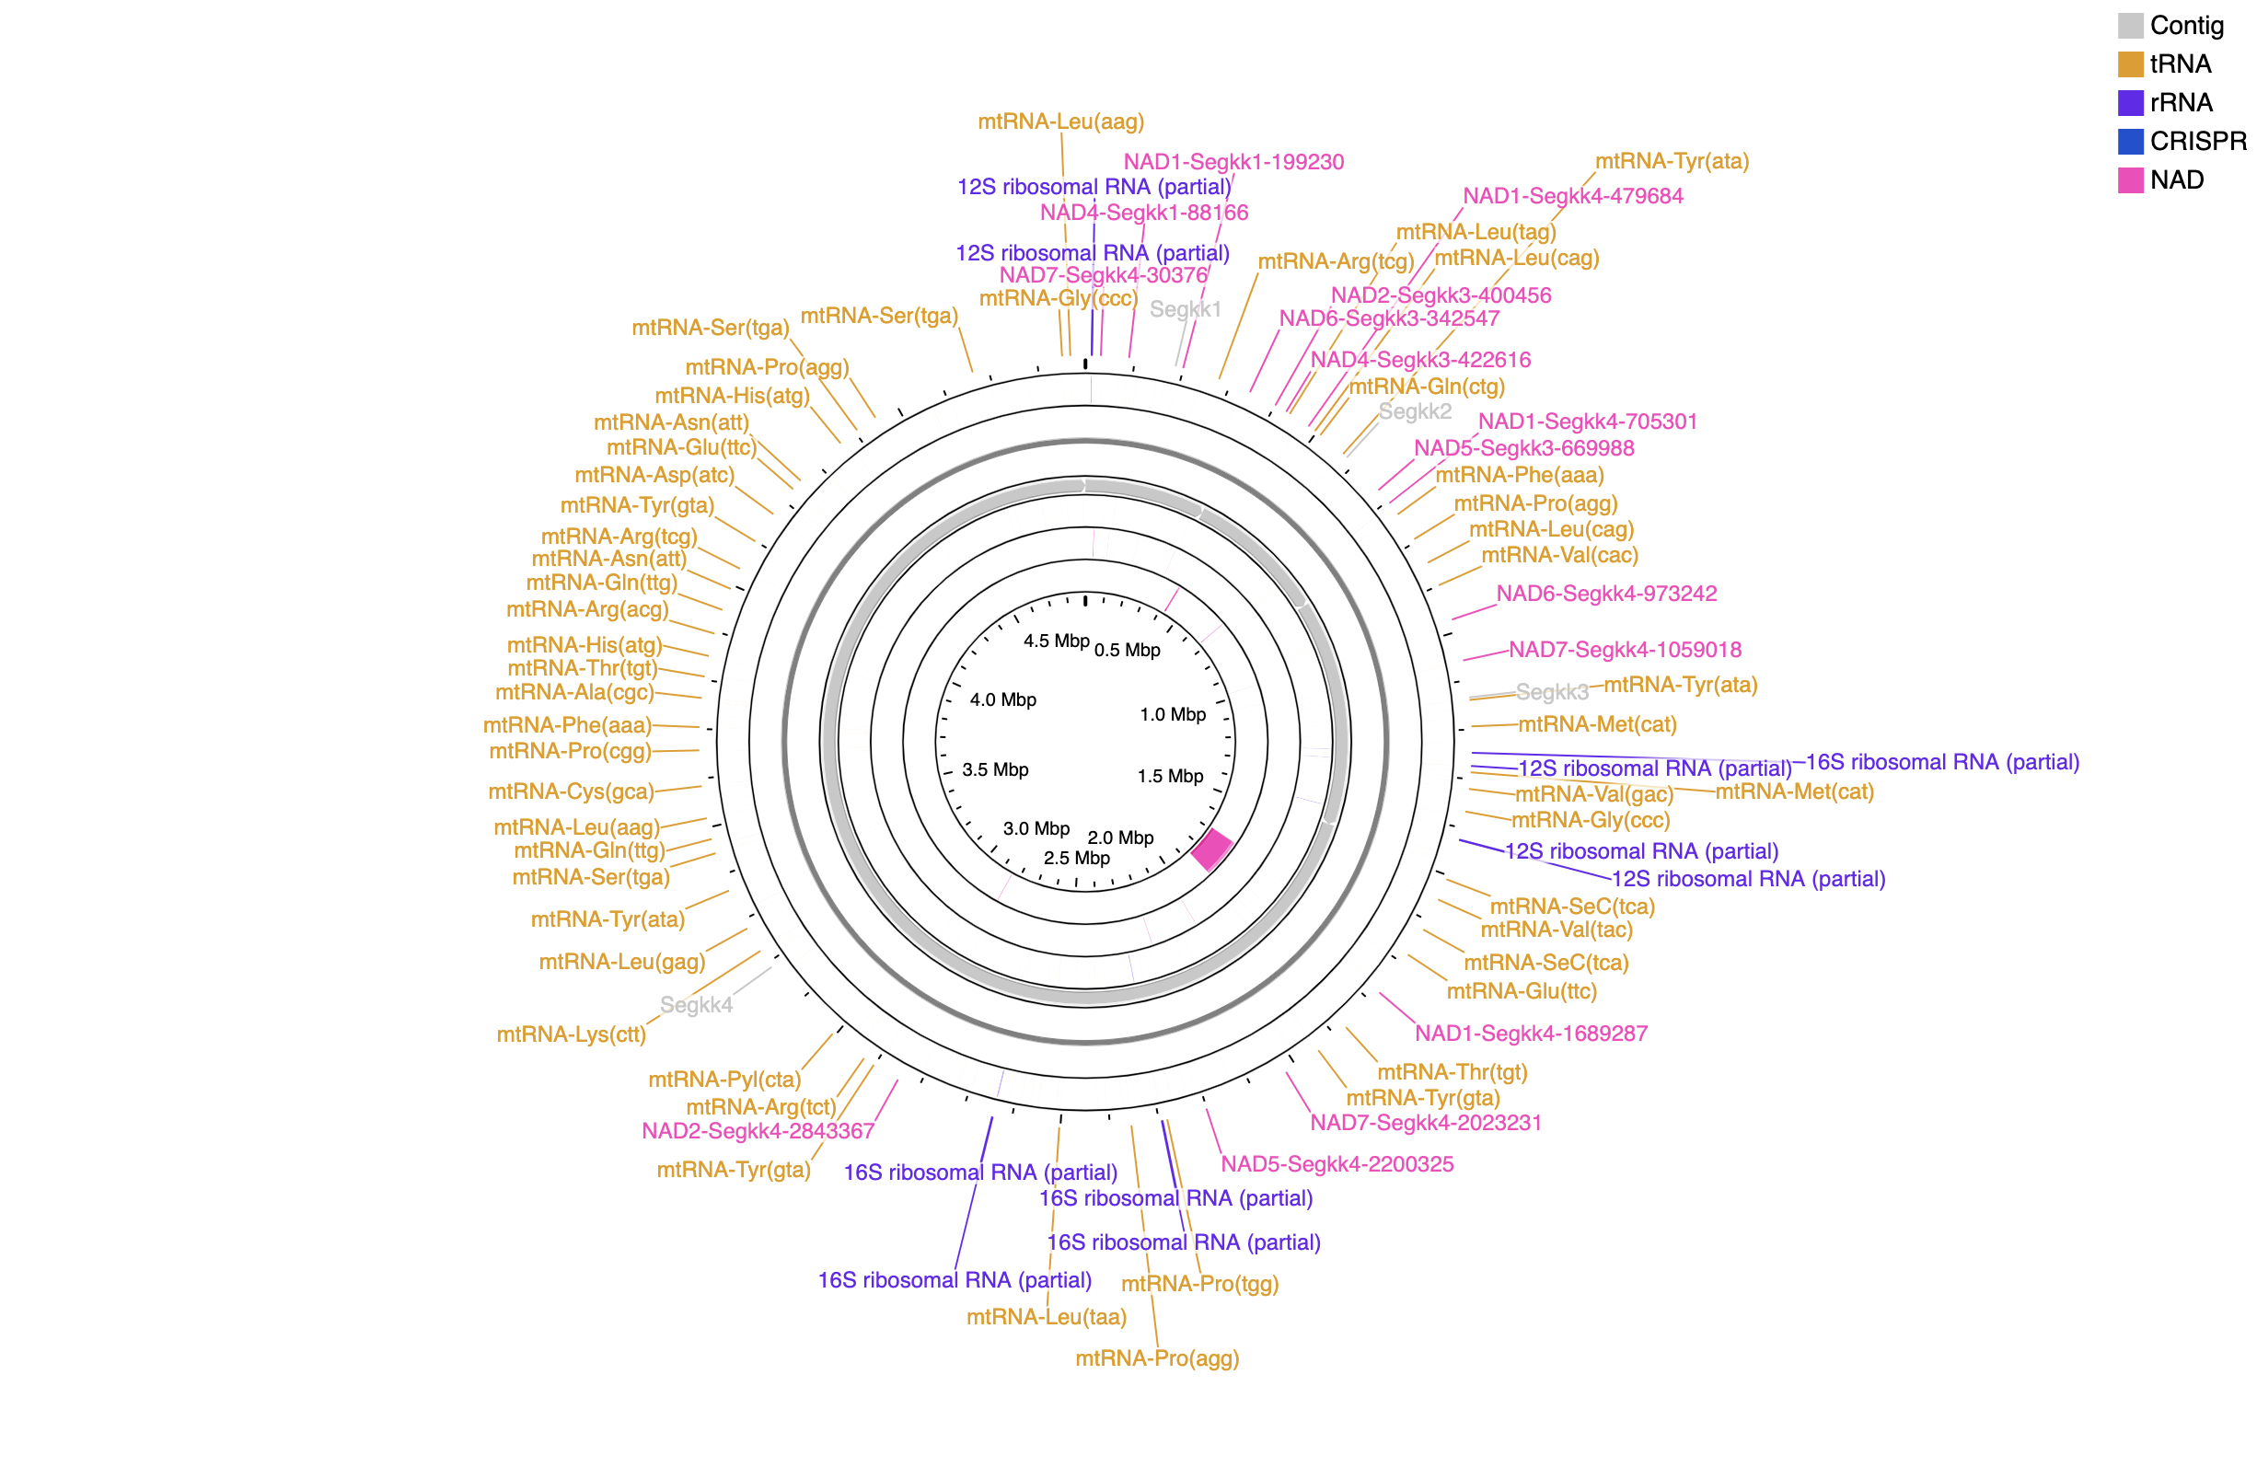
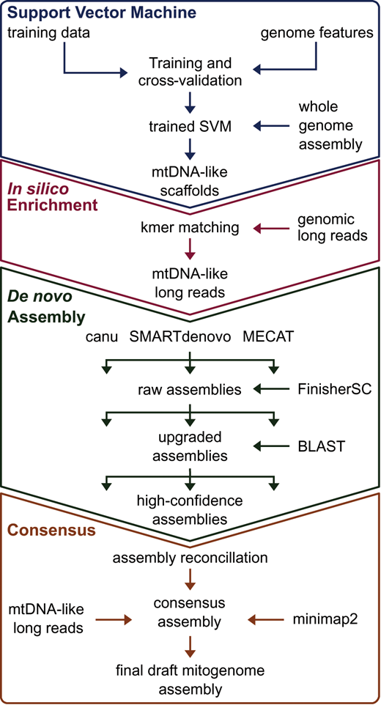
Multiple copies of NAD1 were found
Among the selected scaffolds, several copies of NAD1 gene were found, confirming the PCR data, but they were located on scaffolds less than 1kbp in length, which made it impossible to conclude whether it belongs to the mitochondrial or nuclear genome.
Fig. 7 Picea mitochondrial genome visualized in CGView
Fig. 8 mtDNA classificator by Sullivan A. et al.

Slide 9
Conclusions
The rough plastome assembly was made for four Iris species: I.lycotis, I.munzii, I.filifolia и I. pamphilica;
The phylogeny analysis for 10 species confirmed the previous results, obtained by five chloroplast genes (Wilson, 2011);
Several copies of NAD1 gene in Picea abies were found, confirming the gel electrophoresis data for this gene.

Slide 10
References
Nystedt, B., et al. (2013). The Norway spruce genome sequence and conifer genome evolution. Nature 497, 579–584.
Sullivan et al. (2020) Long-term thermal sensitivity of Earth’s tropical forests. Science DOI: 10.1126/science.aaw7578.
Wilson, C. (2011). Subgeneric classification in Iris re-examined using chloroplast sequence data. Taxon. 60. 27-35. 10.1002/tax.601004.

